Slide 1
DIGITAL DATA
Chapter 1 of 10

Slide 2
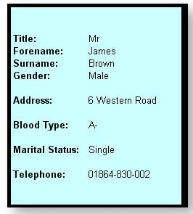
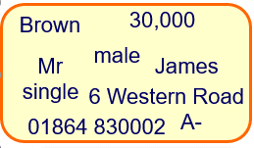
 Data
Unprocessed, raw facts and figures with no meaning or context attached.
 Information
Data which has been given meaning and has been placed in context.

Slide 3
Storing data on a Computer
We store data in a digital way by using binary
This Binary digit (BIT) can be given a value of 1 or 0
A nibble is 4 of these bits
A single character (letter/digit/etc) can be represented by 1 byte (8 bits)
  1 Kb = 1024 bytes
  1 Mb = 1024 Kb
  1 Gb = 1024 Mb
  1 Tb = 1024 Gb
You may have heard these terms used when describing computer memory or capacity of USB’s or Hard drives.

Slide 4
BIT
Nibble
Byte
Kilobyte
Megabyte
Gigabyte
Terabyte
The smallest unit of digital data is a BIT, which is simply a 1 or a 0.
  Not very useful on its own, other than “on” or “off”
A nibble is 4 bits.
  A Hexadecimal digit can be stored as this.
A byte is 8 bits.
  A letter on the keyboard uses 1 of these.
A kilobyte is 1024 bytes
  Probably enough for a text file.
A Megabyte is 1024 Kilobytes
  Around 1min of audio.
A Gigabyte is 1024 Megabytes
  Around 20mins of HD video
A Terabyte is 1024 Gigabytes
  Around 5-15 modern video games

Slide 5
Representing Text & Numbers
Much like databases and spreadsheets, computers can store several different data types. These include:
  Numeric (int/double)
  Date/Time
  Text (Character/String)
 QUICK TASK
Use the internet to describe and give an example of each of these data types when storing data.

Slide 6
Using Pixels
Images use a series of pixels, which is the smallest unit of a digital image that can be displayed and edited on a computer screen.
  Each pixel has its own individual colour and is stored as a series of binary digits.
  Placing/combining these pixels together form a complete image.
  Images have an image resolution, which refers to the quality of a digital image
    The greater the resolution, the bigger the file size will be
  A JPEG file uses 24 bits to store each pixel in an image.
 Pixel
Definition Here
 Image Resolution
Definition Here

Slide 7
Bitmap Images
What you have just done is fundamentally how bitmap images work, which use a grid of pixels to make up an image. There’s a little more to it, but in short we can recreate images using this style.
Computer monitors use pixels, which help from the GPU, to display pixels on screen in their rightful colours (or nearest available match)
In order to store an image on a storage device:
  every pixel needs to have its colour code stored;
  metadata such as the dimensions of the image need to be stored in order to allow the image to be reconstructed for the screen display.

Slide 8
Bitmap Images
Made up of a grid of pixels
Higher the resolution, the higher quality of the image
  More pixels = better resolution
  However, will require more storage
Each pixel can be a different colour, so images can be very complex and detailed
Bitmap images can be compressed, but the reduced file size may result in lower quality
Pixelation occurs if you zoom in too much
Example File type: JPEG

Slide 9
Vector Graphics
Doesn’t use a grid of pixels, instead stores information about components that make up the image
  I.e. lines, curves and shapes
  Can edit these shapes individually by editing the:
    Colour
    Size
    Position
Do not depend on resolution for quality
Require less storage space than bitmap graphics
Can be easily enlarged without affecting quality of image produced
Good for logos / shapes rather than detailed photographs
Example File type: SVG

Slide 10

Representing Video
Streaming allows a video to be viewed on a website without having to download the video completely before starting viewing
  Little-no delay
The user can start watching the video as it is being downloaded in ‘real time’
A buffer is part of the memory used to store a downloaded part of the video before it is being watched.
  As the buffer is being watched, the next part of the video is being downloaded
  Prevents possible disruptions if there are time delays in downloading/streaming

Slide 11
Converting Sound into Digital Format
An analogue signal is a continuous varying signal that represents a physical quantity such as sound
Before a computer can understand/use an analogue signal, they must be converted into binary.
We need to first capture this signal (using a microphone, for example) and recorded as binary using a analogue to digital converter (ADC)
This process of analogue to digital conversion uses sampling to achieve this.

Slide 12
Sampling
An ADC will ‘sample’ (check) the sound level at regular time intervals
The number of samples per second is known as the sample rate
This ‘sample’ is checked and the level is recorded to the nearest whole number
We lose quality as we don’t take into account what the sound wave is doing between these samples
To increase quality, increase the sample rate
  However, set it too high and the file size will be very high

Slide 13
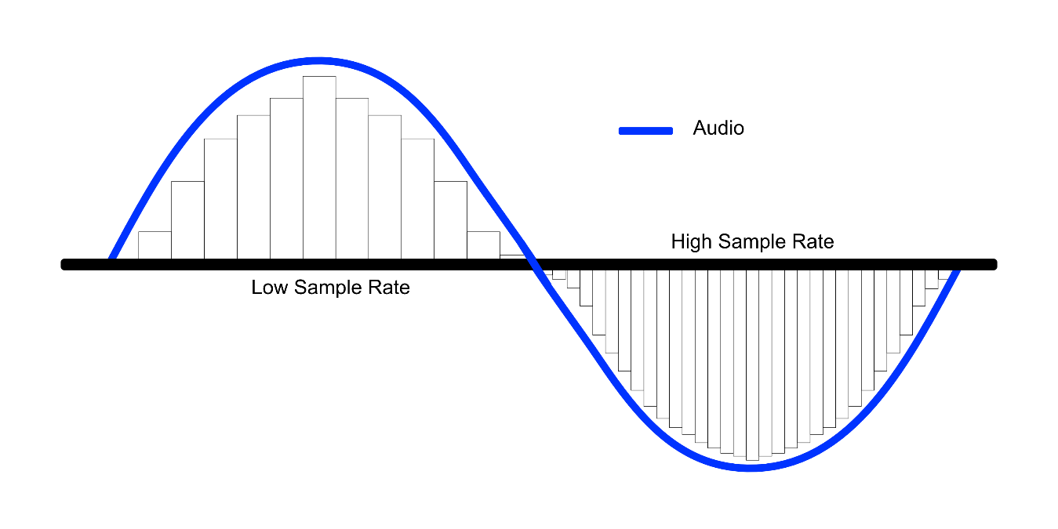
Height of wave = Amplitude
When the sound is sampled, the computer system will round this reading to the nearest whole number and then store this value as binary.
The gap between each sample of sound is known as the sample rate
The closer the samples, the closer the sound will be to the original

Slide 14
 Question
Q. Explain how sound is recorded and stored on a computer
Sound is recorded using a microphone [1]
As sound is a continuous varying signal, it is in analogue format [1]
The system will sample the sound [1]
At regular intervals. This is known as the sample rate [1]
Once the system has received this reading, the system will round to the nearest integer [1]
And this value is stored as binary on the PC [1]
This conversion is known as analogue to digital conversion [1]
[6]

Slide 15
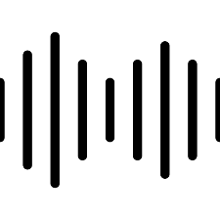
Representing Sound
How is sound quality affected?
There are three main factors that affect the quality of sound:
  Sample Rate – number of audio sound samples captured per second to represent the sounds digitally, measured in hertz (Hz)
  Bit Depth – The number of bits used for each sound sample
  Bit Rate – The quantity of data measured (in bits) that is processed in a given amount of time (usually per second), calculated using the formula Bit Depth x Sample Rate = Bit Rate
Notes:
Standard CD audio (44.1kHz) 44,100 samples per second

Slide 16

 Question
Q. Distinguish between sample rate, bit depth and bit rate.
The SAMPLE RATE is the quantity of samples taken per second [1]
to represent the sounds digitally. [1]
It is measured in Hertz (Hz). [1]
The BIT DEPTH is the number of bits that is allocated per sample taken [1]
The BIT RATE is the number of bits required to store 1 second of sound. [1]
The unit of measurement is b/s or kb/s [1]
Bit depth × Sample rate = BIT RATE [1]
[6]

Slide 17
Data Portability
Different types of data need to be stored using particular formats to ensure data is portable between different applications/computer systems
In order for computer systems to be able to understand how it should be handling a piece of data, the data needs to be given a file type.
 Data Portability
The ability to transfer data from one computer to another or from one software application to another without having to re-enter data.

Slide 18
JPEG
Joint photographic experts group
Supports Compression of images. The level of compression can vary and can be controlled by the user. Higher compression = reduce Quality but will reduce file size
Used for compressing a sound file to decrease file size yet maintain the original level of sound quality when the file is played.
mp3
Moving Picture Experts Group Audio Layer 3
tiff
Tagged image file format
Store Bitmapped images. Allows for portability between windows PC and Apple Mac. Retain their quality but larger file sizes than JPEGs
Similar to MP3, but compresses both sound and video to decrease the storage size. Can also store still images and text subtitles. Allows data streaming across the internet
mp4
Moving Picture Experts Group Audio Layer 4
png
Portable networks graphics
Supports Compression of Bitmapped images. Developed to support sharing of graphics via the internet whilst maintaining quality of image.
A communication protocol that allows sound samples to be interchanged between different musical instruments
midi
Musical instrument digital interface
pict
picture
Standard file format for Apple Graphics. Support graphic interchange between bitmapped and vector based graphics.
Refers to a group of experts who developed standards for compressing digital video
mpeg
Moving picture experts group
gif
Graphics interchange format
Does not degrade quality during compression. Small bitmap file sizes, and can be animated by supporting multiple images being placed in a series.
A multimedia file format created by Microsoft for windows software. Can contain both audio and video content allowing synchronous audio-with-video playback
avi
Audio video interleaved
txt
text
Contains no formatting. Can be opened by any word-processing program to allow for text editing.
Developed by Adobe Systems and can be created from a range of files. It captures formatting used so the original fonts/images/etc of the file are the same. Small file size.
pdf
text
csv
Comma separated value
A text format file often used by database and spreadsheet applications. Can be easily imported into a spreadsheet as each line represents a new row in an excel spreadsheet.
A file format standard for storing an audio bit stream on PCs. It is an uncompressed file format
wav
Waveform Audio File Format
rtf
Rich text format
Used for text based documents and supports basic formatting. Allows for portability between different operating systems as well as word processors.
An Audio compression file format developed for Microsoft Media Player.
wma
Windows Media Audio

Slide 19
Data Compression
By compressing data, we can reduce upload/download time and also reduce storage requirements.
There are two main types of data compression
 Data Compresison
It is used to convert digital data to as small a size as possible while still maintaining the quality of the data contained in the file.
LOSSY
LOSSLESS

Slide 20
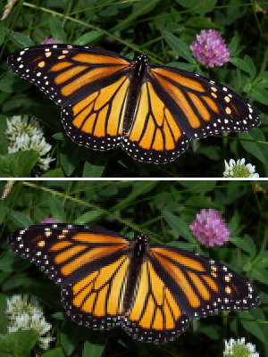
Lossy Compression
Reduces the file size by removing some of the data stored
For example, removing some of the colours available
Can result in a small loss of quality
Once compressed, some data is permanently lost
An example of lossy compression is JPEG

Slide 21

Lossless Compression
Maintains the quality of the file, so no data is lost using this method.
For example, using WinZip to zip a file
The file can be recreated exactly as it was before it was compressed

